Slide 1







Protecting Houses of Worship
Basic Law, Guidance, and Available Resources

Slide 2








Workshop Overview
Current Threats to Religious Facilities
Building Collaborative Relationships Between Houses of Worship and Law Enforcement
Legal Landscape
Overview of Emergency Planning and Resources
Overview of Grants for Houses of Worship
Security and Vulnerability Assessments
Active Shooter Preparedness / De-Escalation / The Power of “Hello”
Panel Discussion Between Religious Leaders, Key Stakeholders, and Law Enforcement

Slide 3
Emergency Planning Support and Resources
Daisy Mueller, Maine Emergency Management Agency

Slide 4
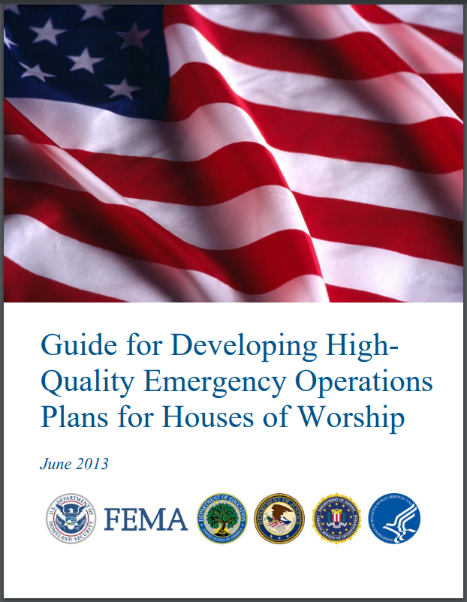
Emergency Planning – What is it?
What is Emergency Planning?
  Documenting what ‘could happen’ and what we will do when it does
Why do we do it?
  To enable and empower us to keep people safe, save lives and protect property
What benefits does it have?
  Builds relationships
  Gives us a guide during stressful situations

Slide 5





Emergency Planning – Where to begin?
5 Mission Areas Identified by FEMA: All-Hazards
  PREVENTION: Prevent, avoid, deter, or stop an imminent crime or threatened or actual mass casualty incident. Prevention is the action houses of worship take to prevent a threatened or actual incident from occurring.
  PROTECTION: Secure houses of worship against acts of terrorism and manmade or natural disasters. Protection focuses on ongoing actions that protect people, networks, and property from a threat or hazard.
  MITIGATON: Reduce the loss of life and property by lessening the impact of future disasters. Mitigation also means reducing the likelihood that threats and hazards will happen.
  RESPONSE: Stabilize an incident once it has already happened or is certain to happen in an unpreventable way; establish a safe and secure environment; save lives and property; and facilitate the transition to recovery.
  RECOVERY: Assist houses of worship affected by an incident in restoring their environment; the health, social, cultural, historic and environmental fabric of communities affected by a catastrophic incident.

Slide 6









Emergency Planning - Considerations
Form a Planning Committee
Planning committee should at a minimum include members of the organization’s leadership and/or those familiar with facility operations.
Review the plan annually
This plan should be reviewed at least annually and updated as needed. As mentioned above, this plan is a living document. People may join or leave the organization or protocols may change over time.
Invite local response partners to either join your planning committee or provide input on your plan.
Brief all new staff and review annually with existing staff
Staff must first know they have a role during emergency operations. Additionally, they must understand their roles and responsibilities during emergency operations.
Consider this plan to be a living document
This plan will likely go through many iterations and should be considered a living document and not something that is set in stone.
Provide a copy of the plan to local response agencies
Local response agencies that will have a role in incident response should be provided a copy of the plan
Tailor the plan to fit the needs of your organization
Conduct exercises/drills on this plan at least semi-annually
Exercises and drills are critical to effective incident
response
Ask Questions
Lean on your first responder and emergency management partners for assistance with any questions.

Slide 7
Emergency Planning – What does it look like?
SCN EOP TEMPLATE: https://cdn.fedweb.org/fed-91/2/SCN%2520-%2520EOP%2520Template%2520-%2520May%25202020.docx
Secure Community Network (SCN), a nonprofit 501(c)(3) organization, is the official homeland security and safety initiative of the organized Jewish community in North America

Slide 8
Emergency Planning – Functional Annexes
Hazard-, Threat-, Incident- Specific Annexes
Severe Winter Weather
Earthquake
Fire
Medical Emergencies
Hazardous Materials Incident
Gas, Fuel and Water Leaks
Utility Failures/Electric
Cyber Incidents
Personal Threat, Assault, Vandalization
Protests
Bomb Threats
Suspicious Mail or Unattended Packages
Active Threat/Shooter
Procedures and Plans
Organization Chain of Command
Communications Procedure
Security Procedure
Missing Child/Vulnerable Person Procedures
Lockdown Procedures
Lockout Procedures
Shelter-In-Place Procedure
Infectious Disease Outbreak Procedure
Recovery Procedure
Evacuation Procedure
Reconstitution Operation Plan
Reunification Procedure

Slide 9
Emergency Planning – Moving Forward
Daunting Tasks and Difficult Discussions
We understand the creation of an Emergency Operations Plan can be a daunting task.
You are not alone in this! Lean on your first responder and emergency management partners with any questions.

Slide 10
Grant Opportunities for Houses of Worship
Rachel Bethea, Maine Emergency Management Agency
T.J. Swenson, Cybersecurity and Infrastructure Security Agency (CISA)

Slide 11
Nonprofit Security Grant Program
Provides funding for target hardening and physical security enhancements
and activities for 501(c)(3) organizations at high risk of terrorist attack.
Annual Award: In FY2022 Maine awarded $1.5 million
FY2022: $1.05 million awarded to 11 nonprofit organizations throughout Maine
Enhancing the protection of soft targets/crowded places
  Physical security measures: fencing, cameras, keycard access, bollards, security screening equipment, private contracted security guards
Effective Planning
  Security risk assessments; development of security plans/protocols; emergency/evacuation plans
​Training and Awareness Campaigns
  Active shooter training, security training for employees, public awareness/preparedness campaigns
​Exercises
  Response exercises (tabletop or full-scale exercises with congregation, police and fire, local emergency management, etc.)
Annual competitive reimbursement grant​
Applications are submitted to MEMA (State Administrative Agency (SAA))
$150,000 maximum for each site
$450,000 maximum per eligible organization (up to 3 sites)
Up to 5% of award funds can be utilized for directly related grant management and administration activities.
Vulnerability/Risk Assessment required
Applications must highlight the specific threats, vulnerabilities, and the consequences due to a terrorist attack
Proposed projects must reflect how the facility will be hardened (made safer/more secure) and/or mitigate the identified risk(s) and vulnerabilities based on the Vulnerability/Risk Assessment
https://www.maine.gov/mema/grants/nonprofit-security-grant-program

Slide 12
Targeted Violence and Terrorism Prevention Grant
DHS Center for Prevention Programs and Partnerships (CP3)
The TVTP Grant Program is the primary financial mechanism through which CP3 supports the establishment and sustainment of local prevention efforts.​
In FY20 and FY21, CP3 funded a total of $30 million in programming to 66 recipients through the Targeted Violence and Terrorism Prevention Grant Program to address four priority areas:
The FY22 TVTP Grant Program adds an additional $20 million to support local communities prevent targeted violence and terrorism. FY22 Grants will address five priority areas:
Prevent Domestic Violent Extremism;
Establish and Enhance Local Prevention Frameworks With an Emphasis on Threat Assessment and Management Capabilities;
Promote Innovative Solutions for Preventing Targeted Violence and Terrorism; and
Challenge Online Violence Mobilization Narratives
Implementing Prevention Capabilities in Small and Mid-Sized Communities; ​​
Advancing Equity in Awards and Engaging Underserved Communities in Prevention;​
​Addressing Online Aspects of Terrorism and Targeted Violence; ​​
​Preventing Domestic Violent Extremism; and ​​
​Enhancing Local Threat Assessment and Management Capabilities.​
https://www.dhs.gov/tvtpgrants

Slide 13
Targeted Violence and Terrorism Prevention Grant
Eligible Applicants
State, Local, Tribal and Territorial Government Agencies
Institutions of Higher Education
Nonprofits (may include Houses of Worship)
FY 2023 Promising Project Types
Raising Societal Awareness
Media Literacy/Online Critical Thinking
Civic Engagement
Youth Resilience Programs
Threat Assessment / Management Teams
Notice of Funding Opportunity (NOFO)
FY 2022: NOFO released on April 12, 2022, applications were due on May 18, 2022
https://www.dhs.gov/tvtpgrants

Slide 14
Security and Vulnerability Assessments
T.J. Swenson, Protective Security Advisor – Maine
Cybersecurity and Infrastructure Security Agency (CISA)

Slide 15
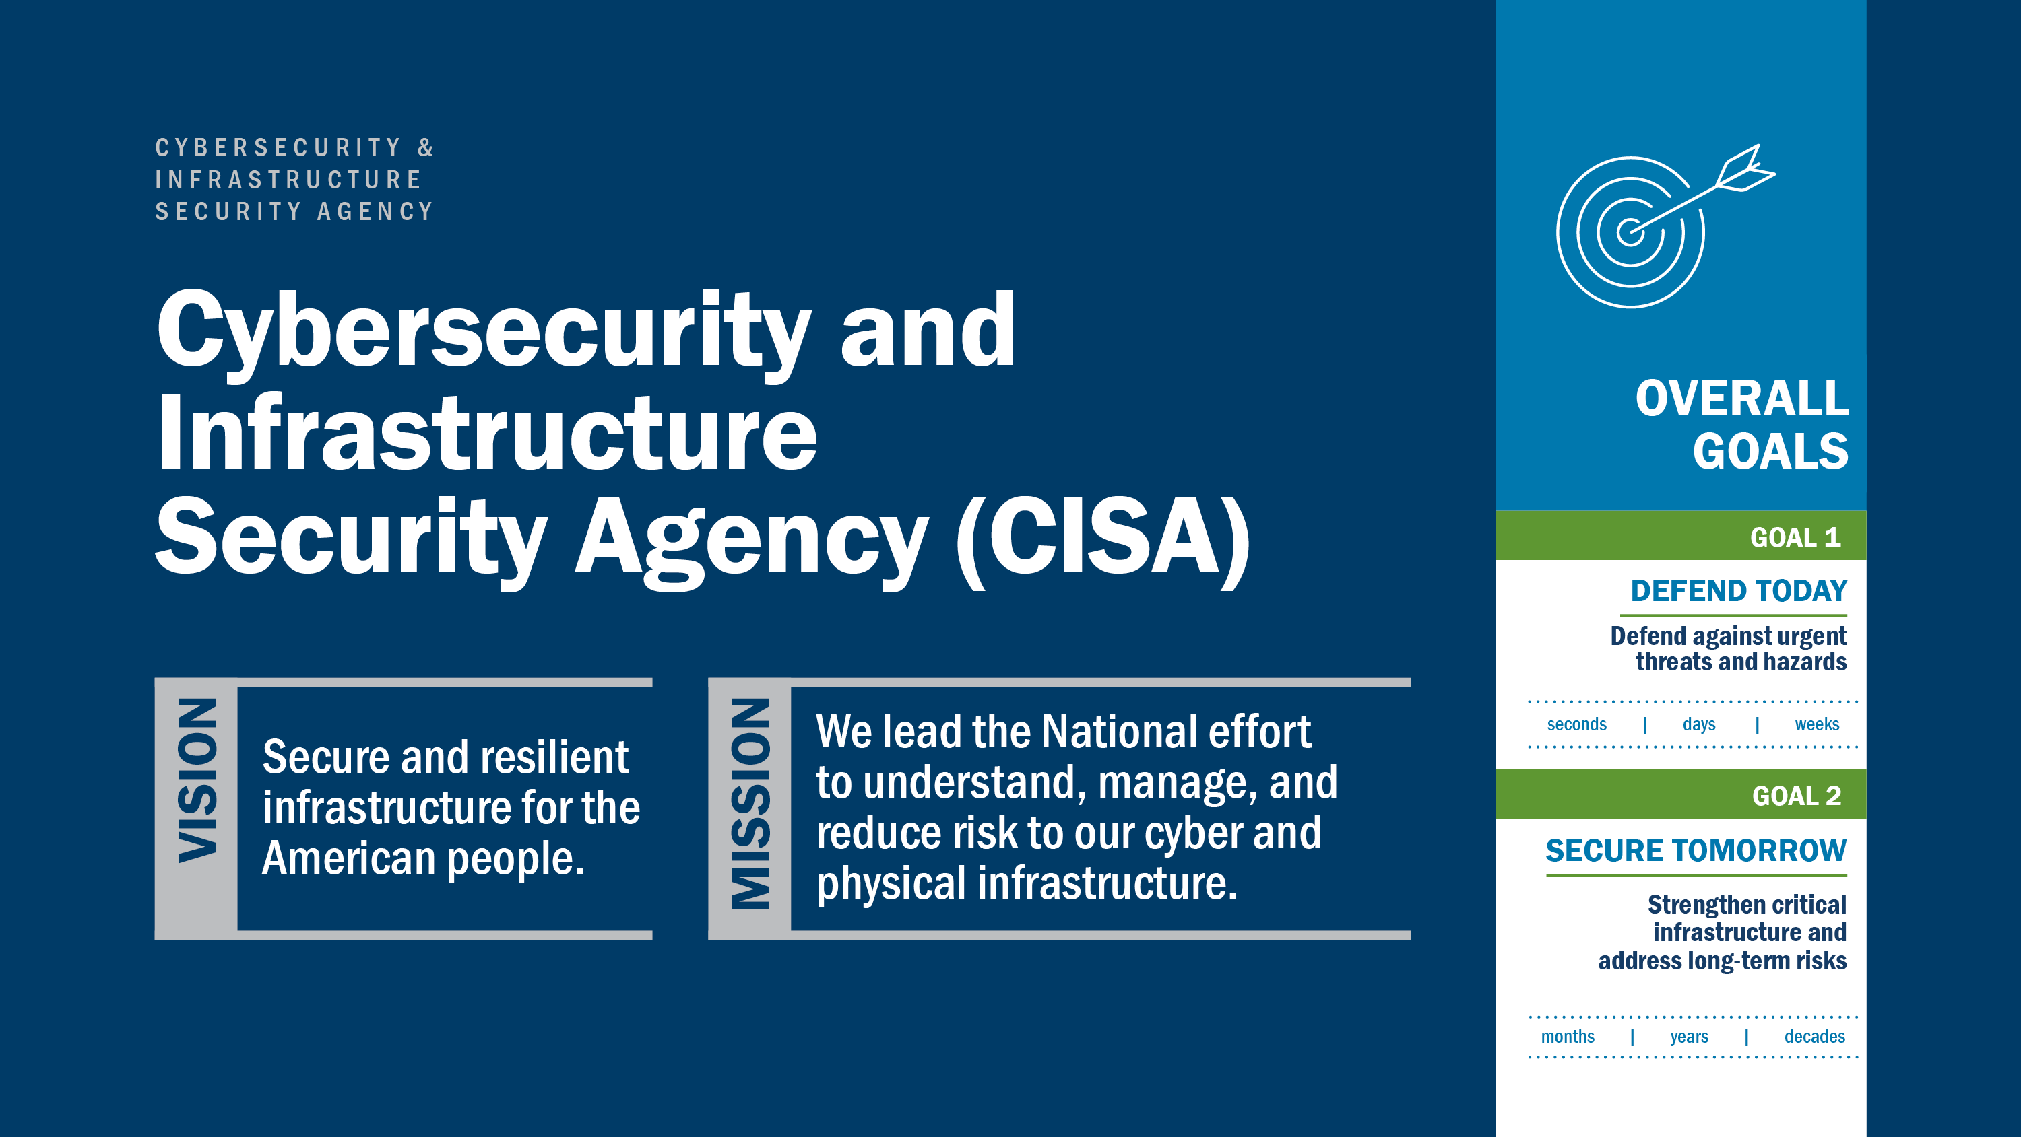

Slide 16
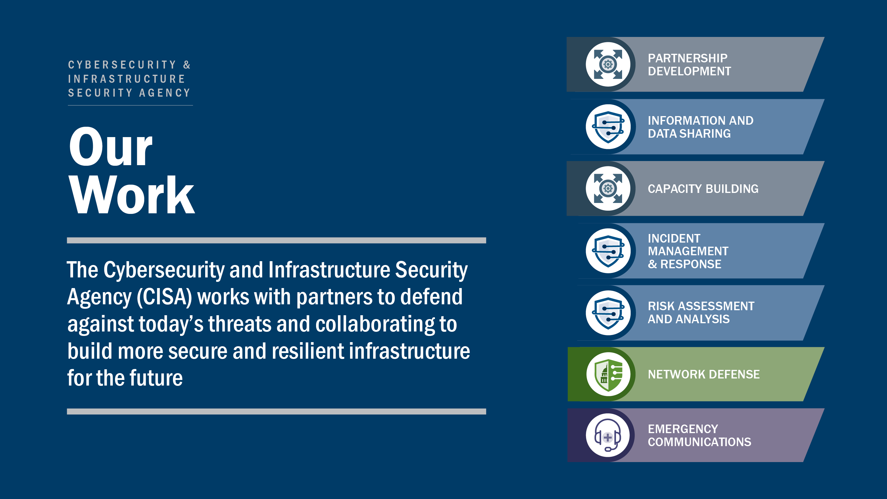

Slide 17
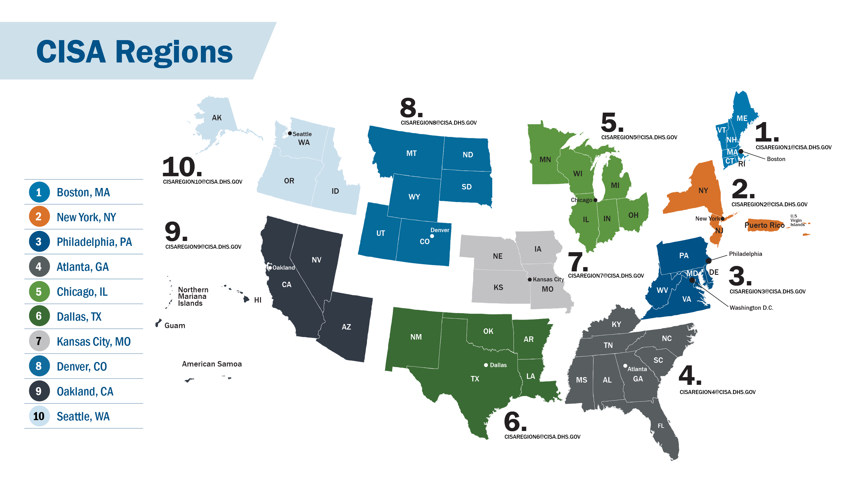

Slide 18
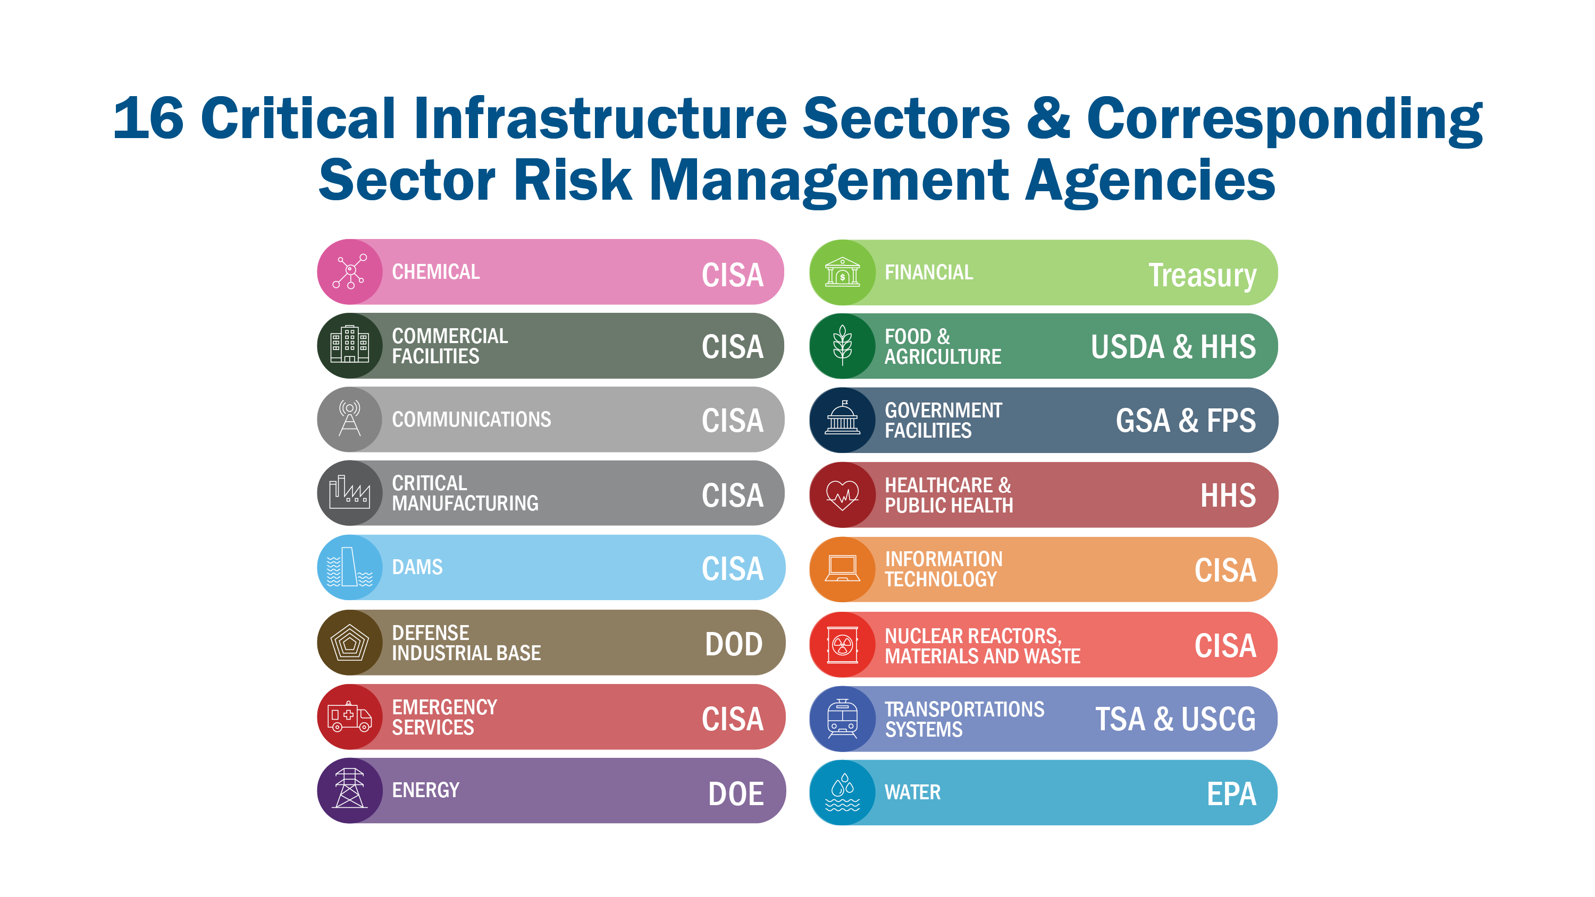

Slide 19
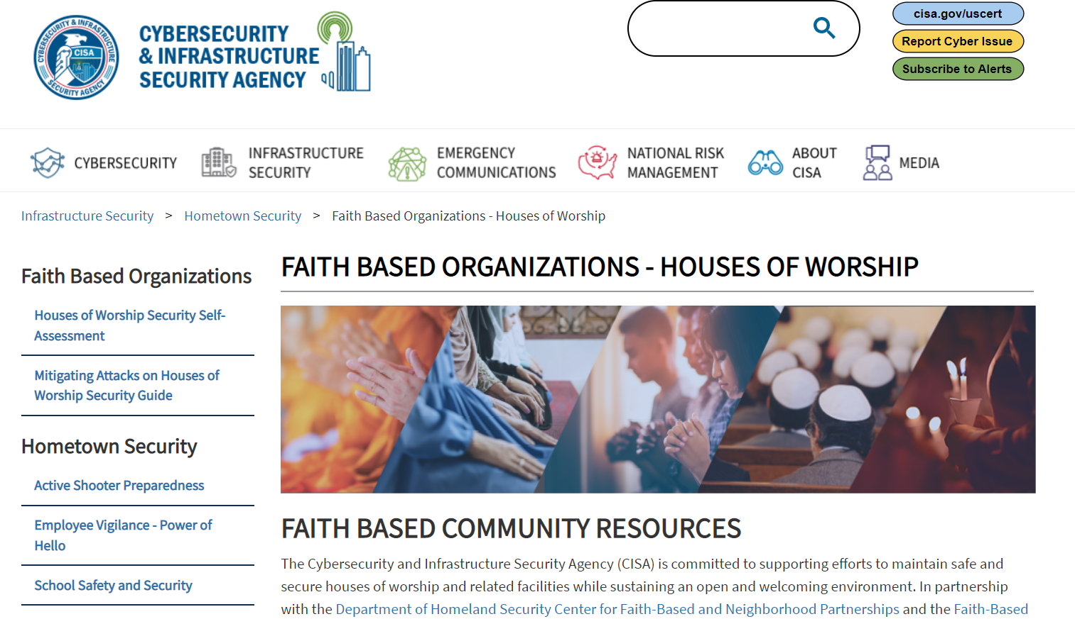
https://www.cisa.gov/faith-based-organizations-houses-worship

Slide 20





CISA Protective Security Advisors (PSAs)
Non-Regulatory, Non-Statutory, Non-Enforcement
Services at NO COST
Assigned to Each State
Collaborate with Federal, State, County and Local Officials, Faith-Based Leaders, and Private Sector Partners
Conduct Security and Vulnerability Assessments, Provide Technical Assistance on Physical Security Matters, and Support Security/Emergency Operations Planning
Provide Advisement, Training, and Many Free Resources (e.g. Active Shooter, Insider Threat, De-escalation, Houses of Worship, School Safety)

Slide 21
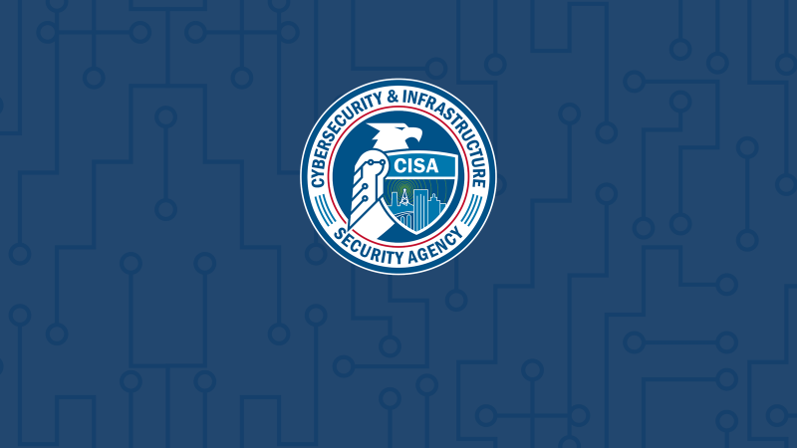
Assist Visits

Slide 22
PSA Security / Vulnerability Assessments
Assist Visit
Purpose: Traditionally occur prior to a formal assessment and focuses on introductions, facility familiarity, enhancing relationships, explaining how the facility fits into a critical infrastructure sector, and an overview of available CISA resources and support.
Description: An informal virtual or physical meeting normally lasting up to one hour. May include discussions focused on the facility’s location, size, staffing, operations, dependencies and role within their Critical Infrastructure sector. Will include an overview of available CISA Support and a discussion regarding next steps (provision of resources, scheduling an assessment, etc.).
Outcome: A plan for the CISA PSA to best support the facility owner/operator.

Slide 23
CISA Houses of Worship/Faith Based Organizations Resources
Houses of Worship / Faith Based Organizations Resources:
Active Shooter Preparedness Program
Office of Bombing Prevention
Cybersecurity
De-Escalation / The Power of Hello
CISA Tabletop Exercise Program (CTEP)
Houses of Worship Security Self Assessment
  Houses of Worship Security Guide
Insider Threat Training and Materials
Protecting Houses of Worship Videos
Soft Target, Crowded Spaces

Slide 24

CISA’s Power of “Hello” and
De-Escalation Series

Slide 25

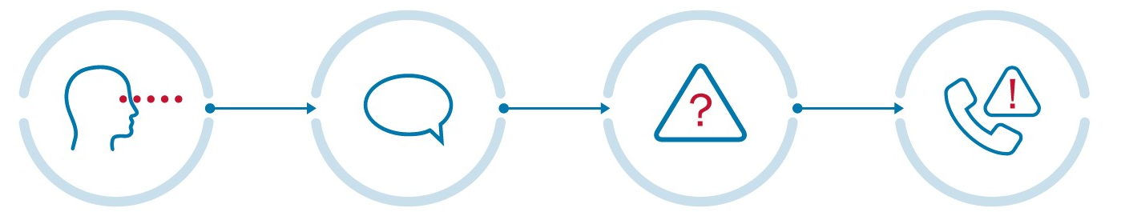
De-Escalation: The Power of “Hello”
Also referred to as the “OHNO” Approach:
  O: Observe
  H: Initiate a “Hello”
  N: Navigate the Risk
  O: Obtain Help
  Helps individuals observe and evaluate suspicious behaviors, empowers them to mitigate potential risk, and obtain help when necessary.
OBSERVE
Be vigilant of your surroundings
INITIATE A HELLO
Acknowledging a risk can deter a potential threat
NAVIGATE THE RISK
Determine if observed behavior is threatening or suspicious
OBTAIN HELP
Obtain help from management or authorities

Slide 26
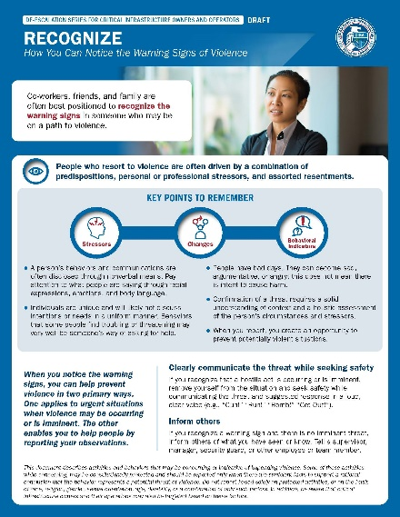
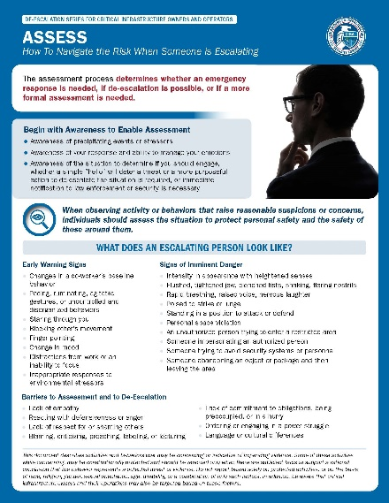
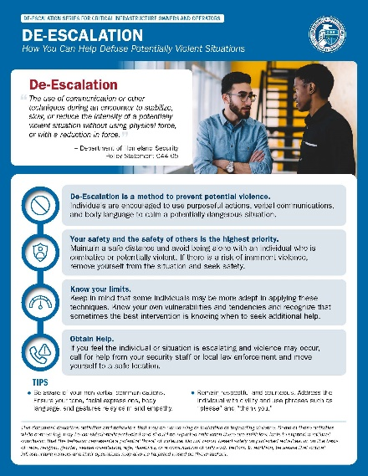
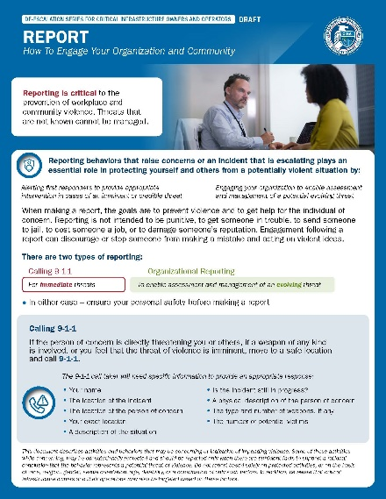
CISA De-Escalation Series
Recognize
The warning signs for someone on a path to violence, identify stressors, changes in baseline behavior, and observable behavioral indicators.
Assess
The situation to protect personal safety and the safety of those around you. Identify what an escalating person may look like and warning signs.
De-Escalation Encourages the use of purposeful actions, verbal techniques, and body language to calm a potentially dangerous situation. Safety is the highest priority, know your limits and obtain help immediately if needed.
Report
Concerning behavior or an escalating incident through organizational reporting to enable assessment and management of an evolving threat, and 9-1-1 for immediate threats.

Slide 27
CISA’s Active Shooter Preparedness Program

Slide 28
CISA Active Shooter Preparedness Program
A comprehensive program that provides videos, training, resources and other support, including:
  Webinars
  Active Shooter Training for Houses of Worship/Institutions
  Printable Resources (Active Shooter Wallet Cards, Posters, and Guides)
  Pathway to Violence
  Threat Assessment Team Composition
  Active Shooter Planning Guidance and Tools
  Run, Hide, Fight Concept
https://www.cisa.gov/active-shooter-preparedness

Slide 29
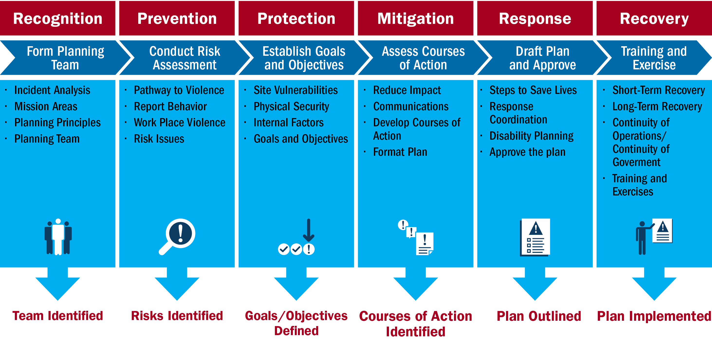
Active Shooter Preparedness Program Overview

Slide 30
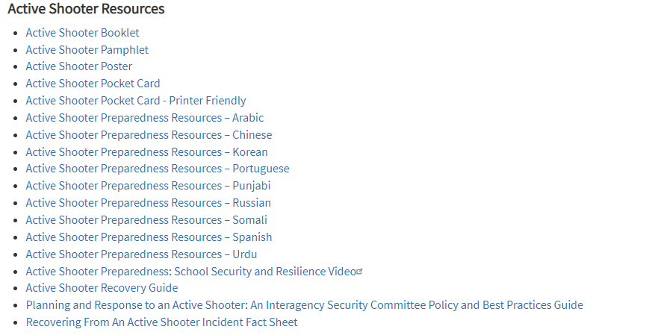
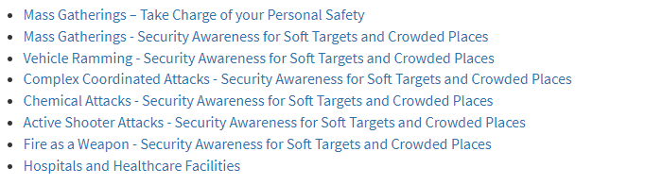
CISA Active Shooter Preparedness Program
https://www.cisa.gov/active-shooter-preparedness

Slide 31
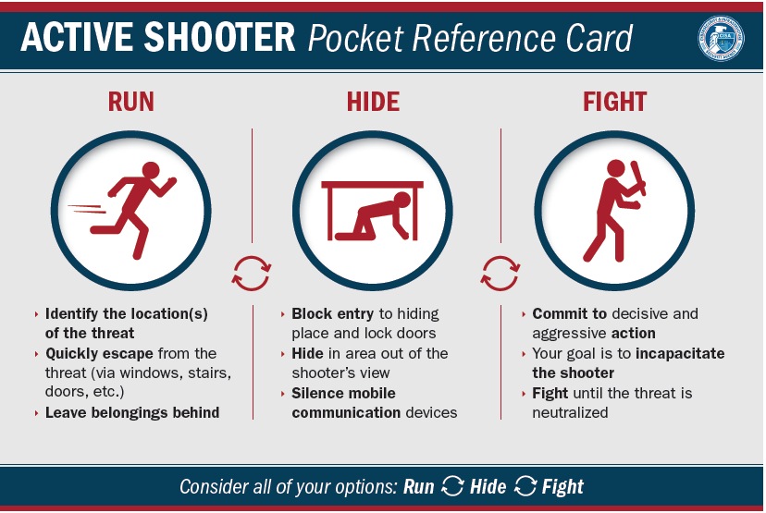
CISA Active Shooter Preparedness Program
https://www.cisa.gov/active-shooter-preparedness

Slide 32
CISA’s Web-Based Houses of Worship Security Self Assessment Tool

Slide 33

CISA Self Assessments
Houses of Worship Security Self-Assessment Tool
Purpose: To guide personnel at houses of worship through a security-focused self-assessment to understand potential vulnerabilities and identify options for consideration in mitigating those vulnerabilities.
Description: A web-based tool that is the first step in building an effective security program. It is not intended to be an in-depth security assessment. After completing this process and addressing preliminary findings, houses of worship personnel may consider pursuing more detailed security assessments to explore specific issues in greater detail.
Outcome: The Houses of Worship Self Assessment will produce a formatted report which includes observed and/or reported Vulnerabilities and Options for Consideration (VOFCs).
www.cisa.gov/houses-of-worship

Slide 34
Houses of Worship Security Self-Assessment Tool
Walk Through of CISA’s Houses of Worship Security Self-Assessment Tool and Example of a Final Assessment Report
www.cisa.gov/houses-of-worship

Slide 35
Security Assessment at First Entry (SAFE)

Slide 36
PSA Security / Vulnerability Assessments
Security Assessment at First Entry (SAFE)
Purpose: To assess the current security posture and identify options for facility owners and operations to mitigate against relevant threats.
Description: A 1–2-hour assessment that includes a review of available plans and procedures, tour, and interviews with facility staff.
Outcome: A formal “SAFE REPORT” which includes observed commendable actions, VOFCs, and available resources. May be PCII protected. Usually provided to the owner/operator between same day to 3 business days. Eligible for PCII protections.

Slide 37
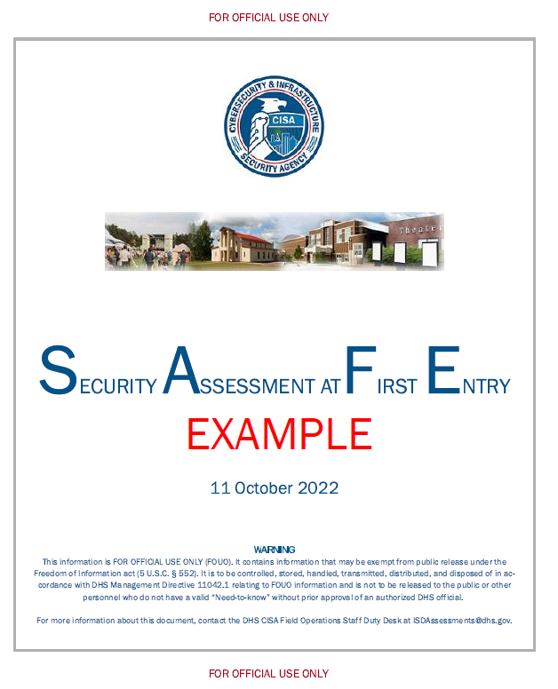
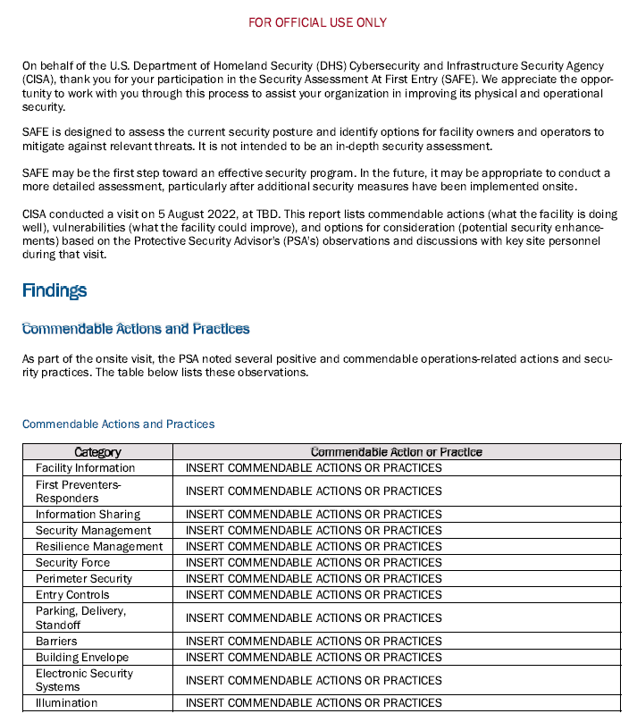
SAFE Example

Slide 38
SAFE Example

Slide 39
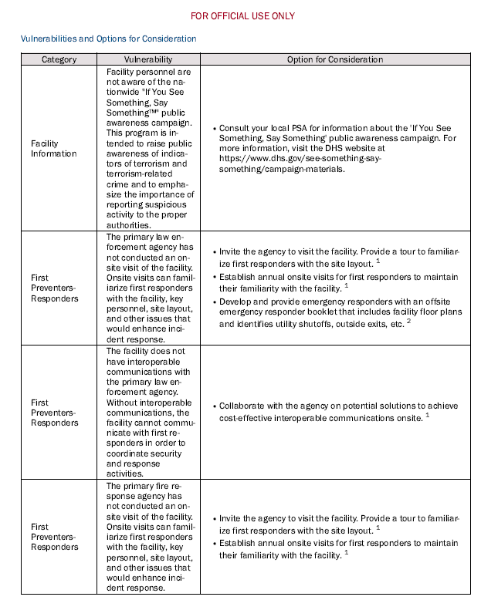
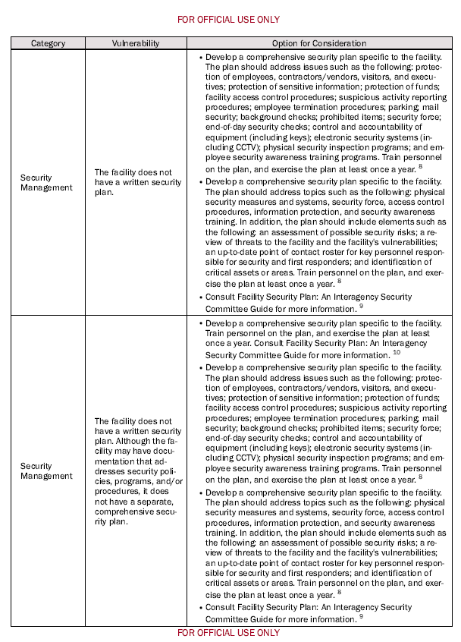


Slide 40
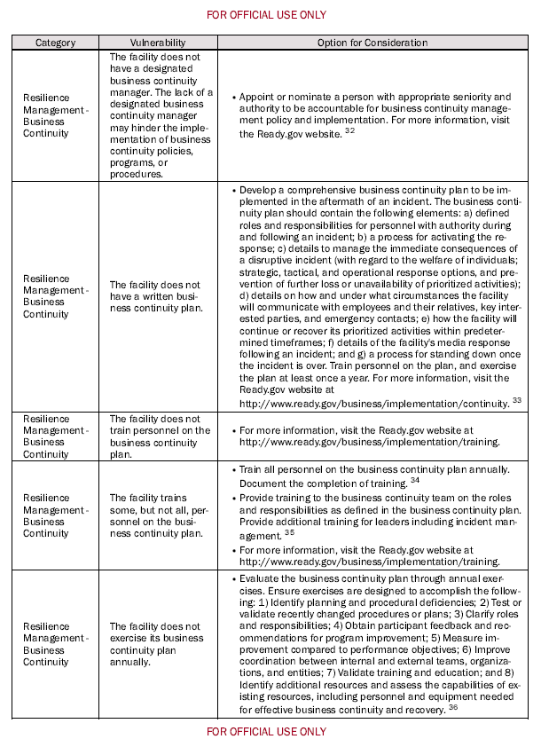
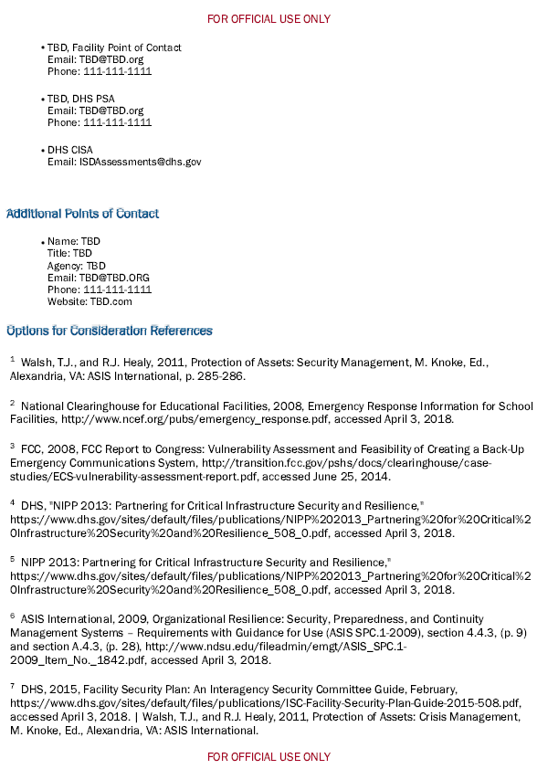

Slide 41
Faith-Based Information Sharing and Analysis Organization (FB-ISAO)

Slide 42

Faith Based Information Sharing and Analysis Organization
The Faith-Based Information Sharing & Analysis Organization (FB-ISAO) provides members with threat analysis, incident reports and other services that help organizations prevent, respond to, and recover from incidents.
With an all-hazards approach, FB-ISAO provides the faith-based community with the information, training and tools they need to enhance the safety, security, and resiliency of their facilities.
Visit https://faithbased-isao.org/membership to begin the process
Email info@faithbased-isao.org with questions

Slide 43
Faith Based Information Sharing and Analysis Organization
FB-ISAO members have access to:
Analytical and incident reports on security topics of particular concern to the faith-based community
Training on topics such as how to develop Emergency Operations Plans
Documents such as the Pandemic Reentry / Reopening Checklist for FBOs
Discussion based workshops that address hostile event preparedness
Access to community centric and community developed best practices
Visit https://faithbased-isao.org/membership to begin the process
Email info@faithbased-isao.org with questions

